Slide 2
GLI always prioritize on mutual success, for win-win scenario for everyone.
The aspiration to go above and beyond the customer’s needs; the collaborative culture that works with you to exceed your project goals; and the capability to leverage innovation to meet emerging trends and keep you at the forefront. This is GLI.
When you partner with GLI, you not only get effective solutions, you get our fully dedicated team and a commitment to doing things right. Our relentless focus on success leads to best customer service.
GLI is not just a construction company but the dealer /distributor of power tools and construction equipment brand such as Makita, Dewalt, Stanley, Hitachi, Robin, Honda, Ryobi, Milwaukee, Skil and many more. We are also the authorized service center to these brands.
We are also in partners with Pebsteel, Avon Philippines, EE Black Ltd, Crimson Group Inc, Mundo Builders, SDW Construction, Excell Contractors and Developers Inc. DPWH, QC LGU, Pugad Lawin, and many more. GLI has collaborated with works or provided services with these companies with great results and success.
GLI does not only supply quality brands in the field of power tools and construction equipment. GLI offers project management solutions, design, fabrication, erection, construction and testing & commissioning. These are on projects like civil works, structural frames, parking solutions, scaffolding systems, prefab buildings, fit outs (architectural, electrical, mechanical, etc) and renewable energy systems (solar, hydro electric, wind, etc).

Slide 3
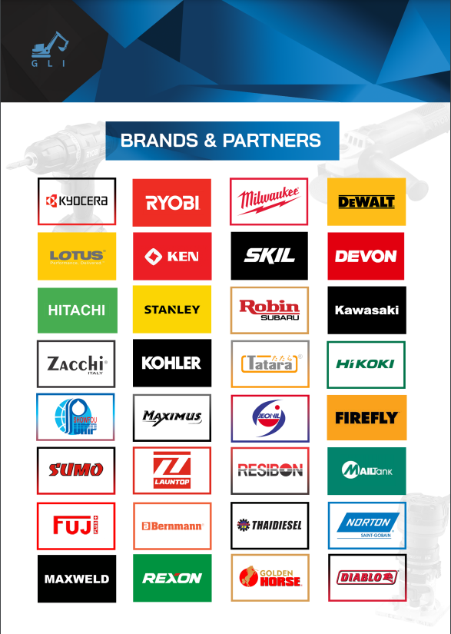

Slide 4
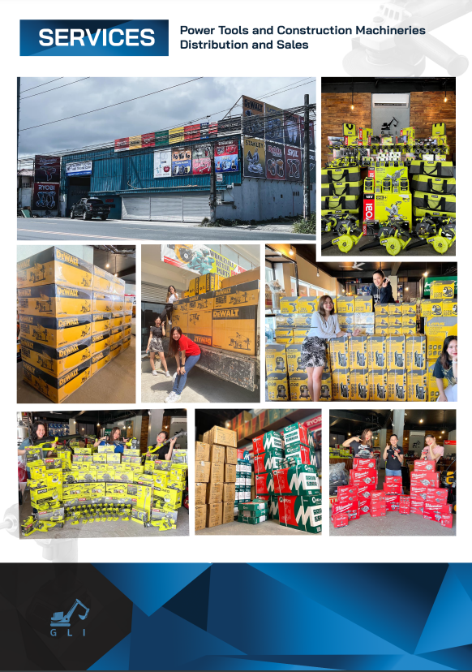

Slide 6
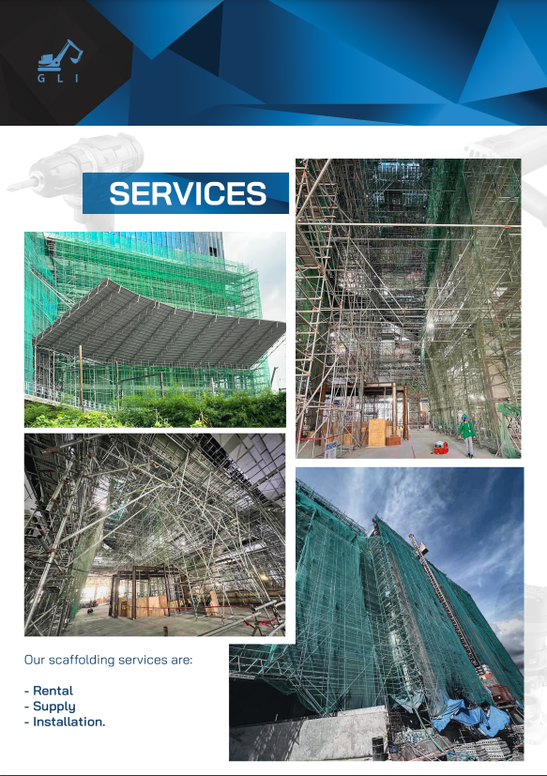
SCAFFOLDING SYSTEM
GLI has installed a total of 270,000 cubic meter of scaffolding materials. We specialize in the design, supply, rental, installation and certification of scaffolding structures

Slide 7
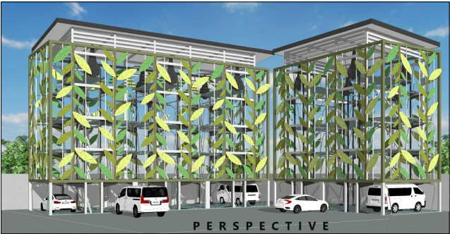
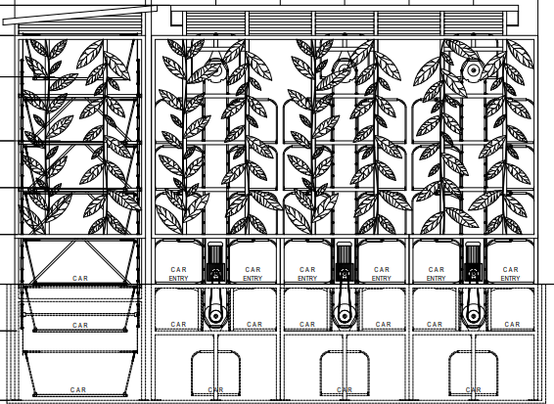
PARKING SOLUTION
GLI designed and installed a total of 25,500 sqm of parking space weighing 2,800 MT of structural steel. GLI caters to either conventional steel structure design or motorized parking systems (carousel or maze).
Illustrated is an on going project at DPWH 4B compound Edsa Quezon City Metro Manila.

Slide 8
PARKING SOLUTION
Four (4) Storey Parking Building – located at Clark Pampanga, 6,500 sqm with 500 MT structural steel.

Slide 9
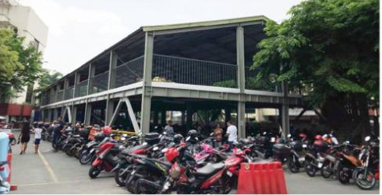
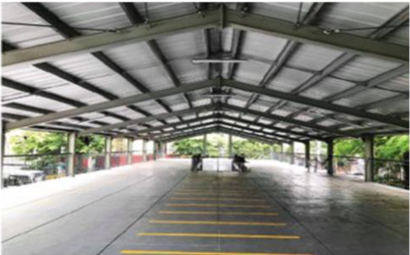
PARKING SOLUTION
Two (2) Storey Motorcycle Parking – located at Makati City, Metro Manila, 1,500 sqm with 115 MT structural steel.

Slide 10
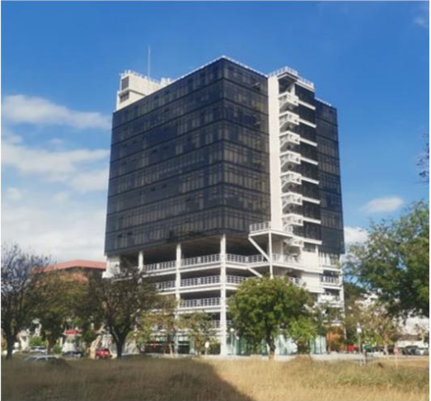
PARKING SOLUTION
Workspace Commercial and Parking Building – located at Madrigal Business Park Alabang, 8,150 sqm with 1,500 MT structural steel.

Slide 11
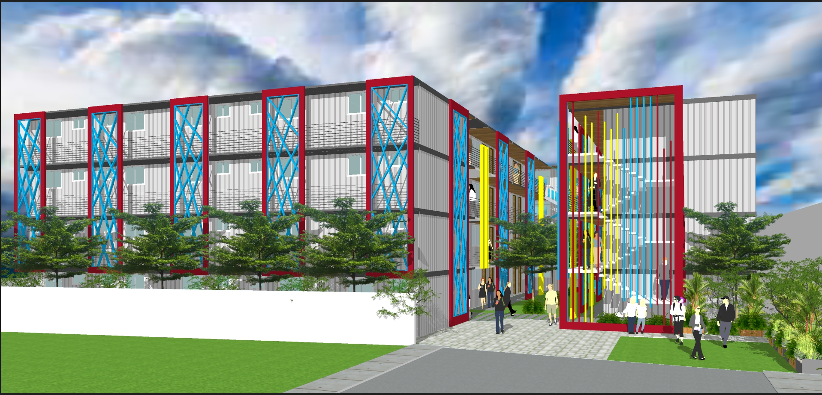
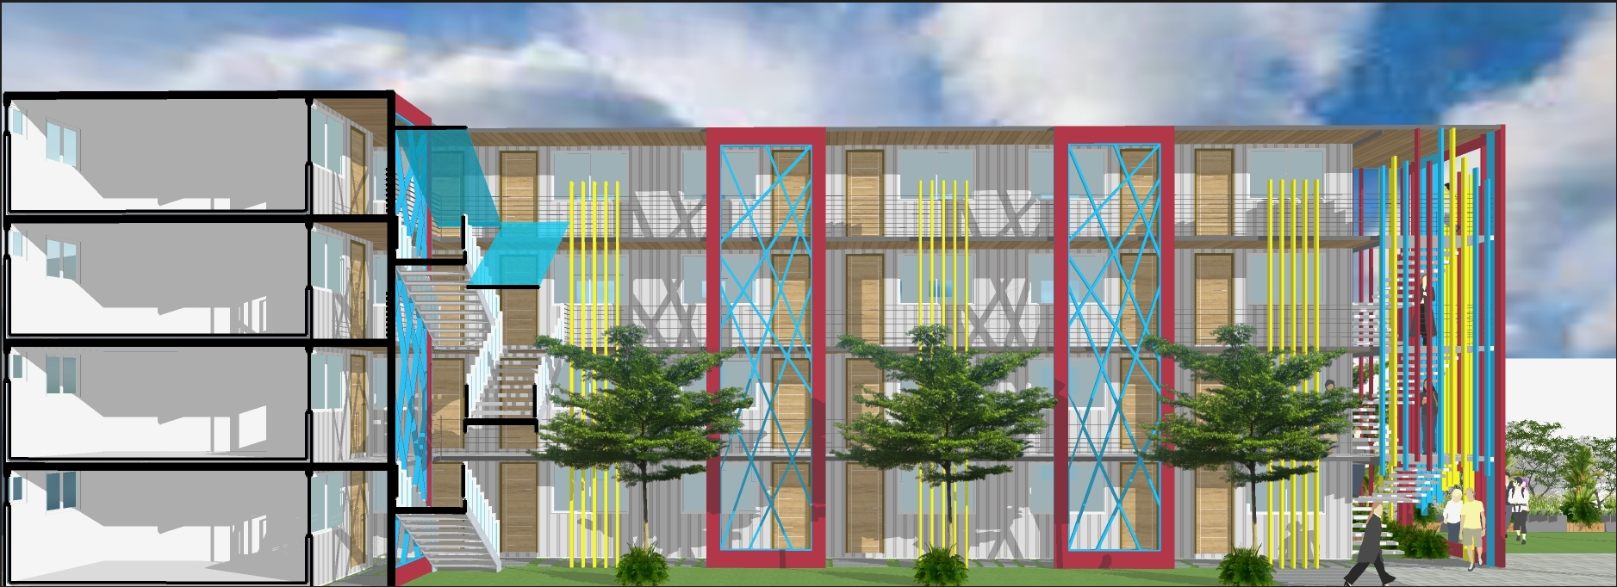
PRE FABRICATED BUILDINGS
GLI designs and installs prefabricated building made of EPS (Expanded Polystyrene System) wall. 2,000 sqm of living space.
Illustrated is an on going project at Sitio Militar Project 8 Quezon City Metro Manila

Slide 12
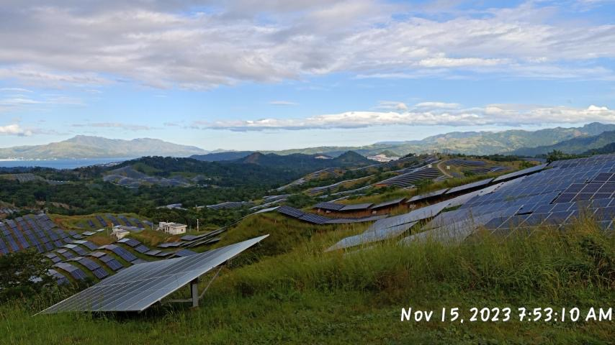
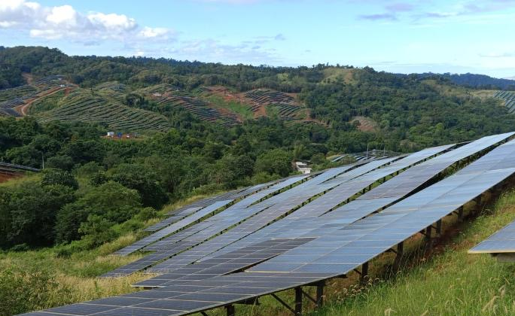
SOLAR POWER PLANTS
Located at Hermosa Bataan with a capacity of 105MW of solar power. GLI can assists with the design, government compliance papers, installation, testing and commissioning

Slide 13
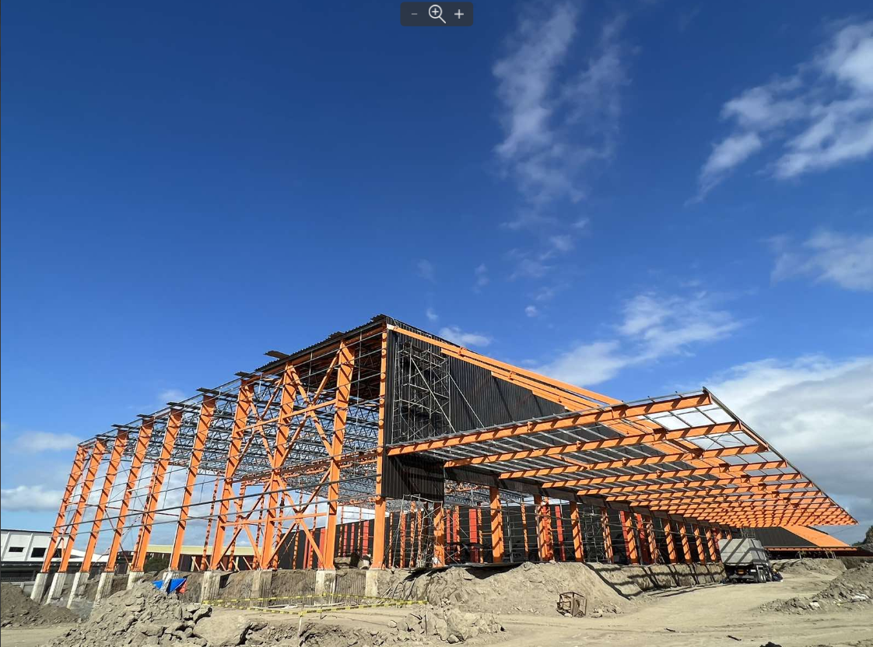
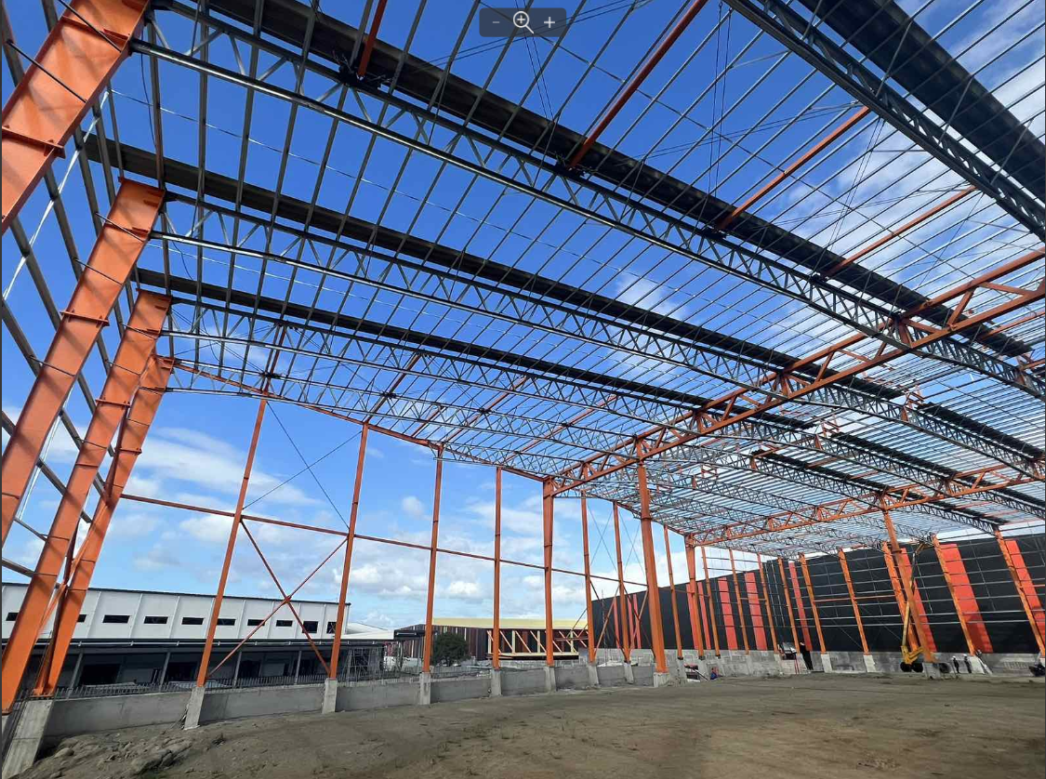
PRE ENGINEERED WAREHOUSE
GLI designs and installs pre engineered building made of light weight steel made in Vietnam.
Illustrated is an on going project at Canlubang, Calamba Laguna with a total of 7,000 sqm of space and 1,000 MT of structural steel.

Slide 14
RESIDENTIAL & COMMERCIAL
GLI has done various residential and commercial projects. This is from conceptual stage to design and execution.
GLI shall have many housing projects line up and soon to start Q1 to Q2 of 2024 in partnership with various LGU and various national government agencies.

Slide 15
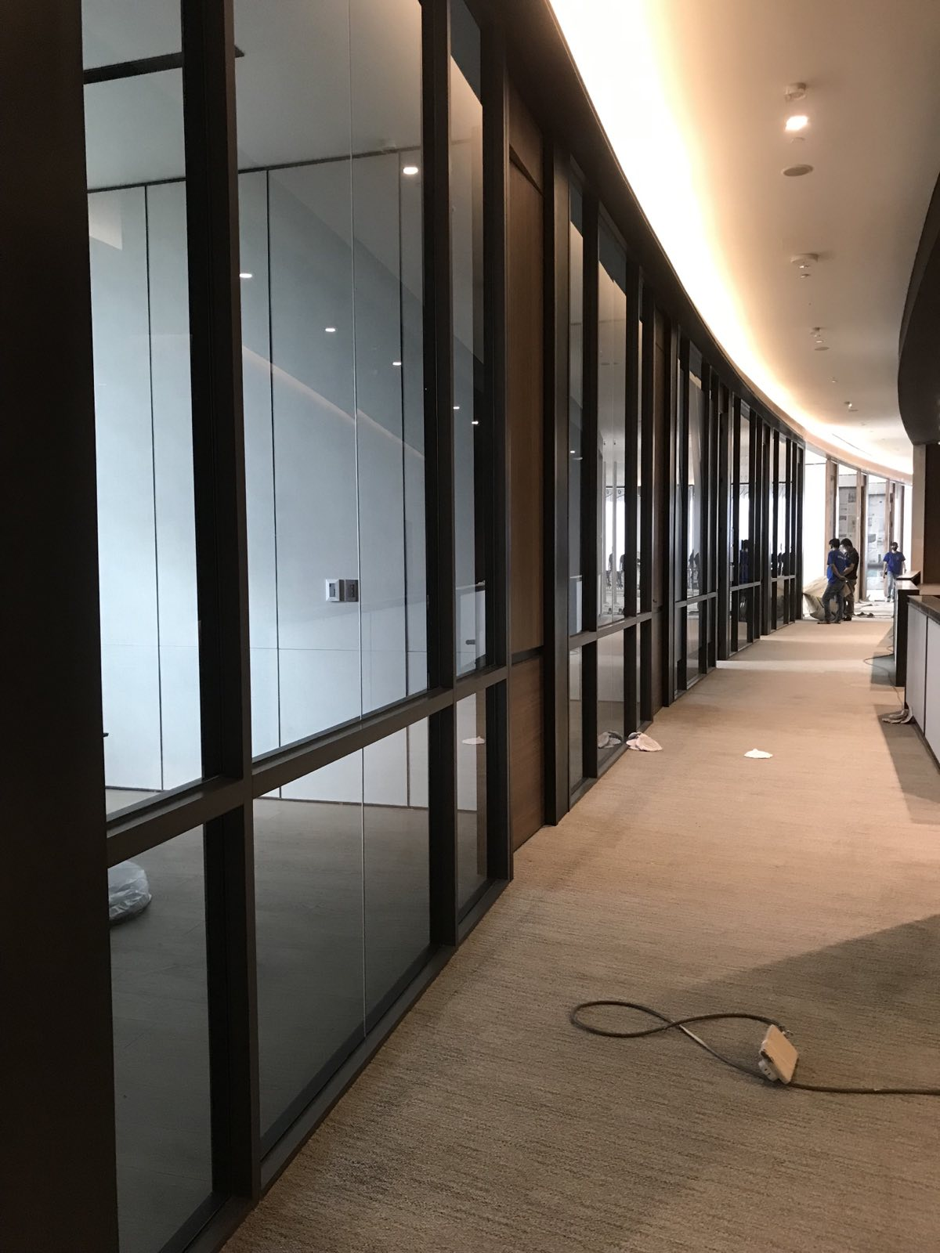
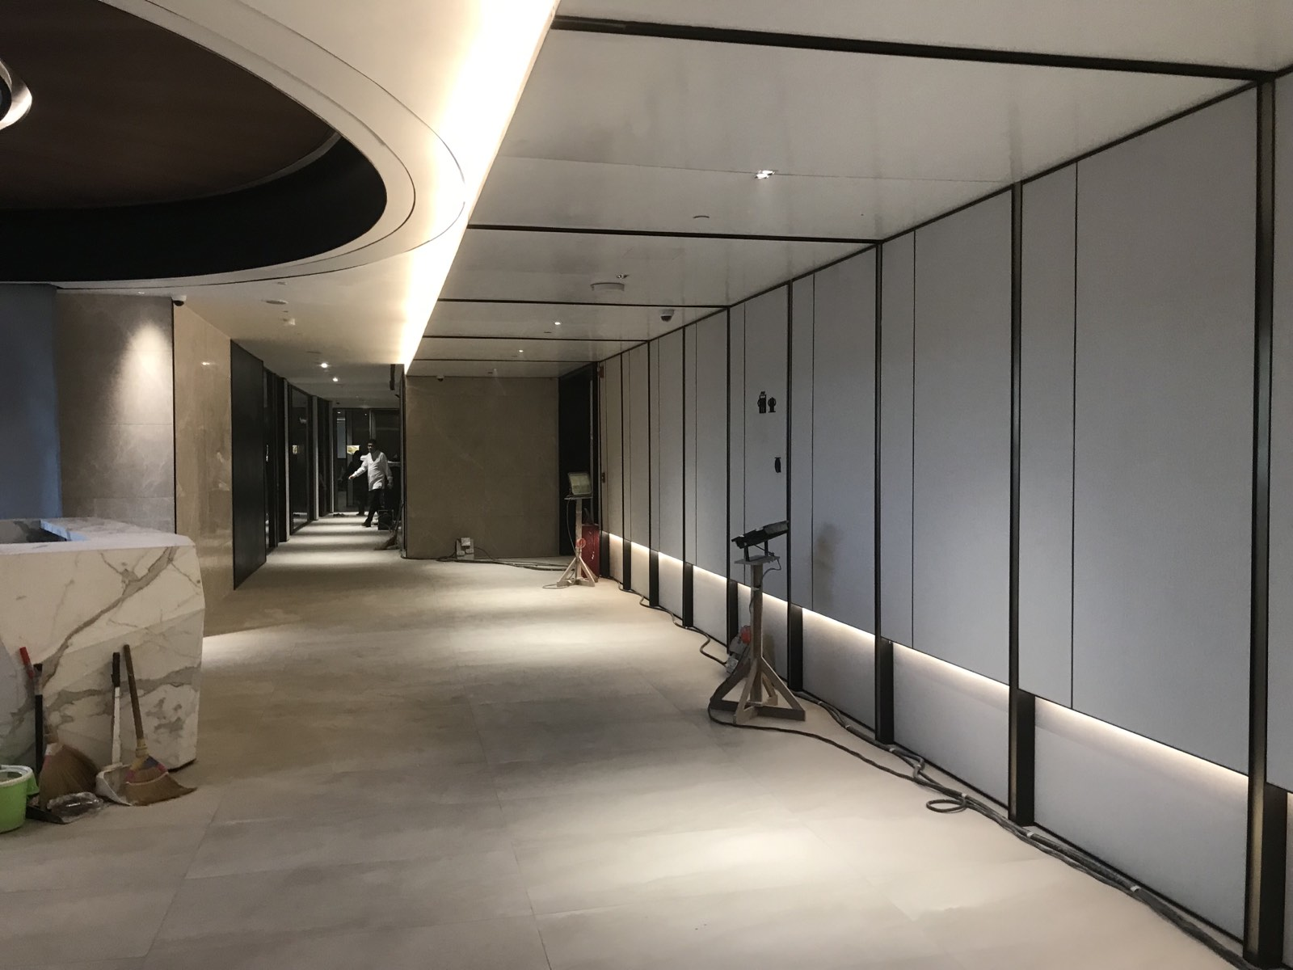
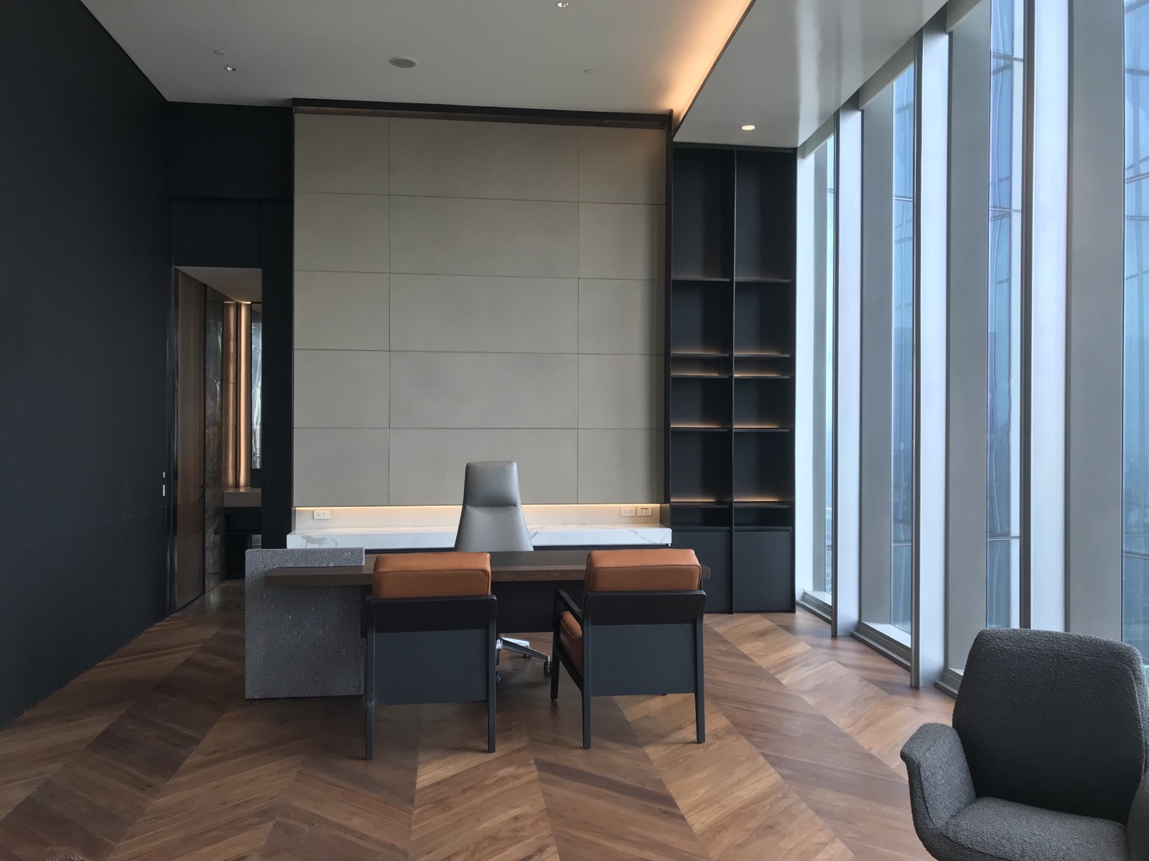
FIT OUT
Ayala Headquarters Tower 2, level 37 to 39 installation of drywall and gypsum ceiling (from framing to final finish).

Slide 16
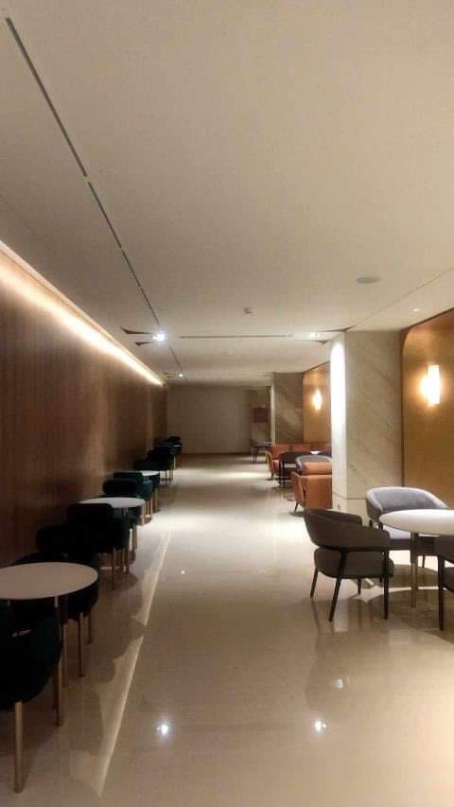
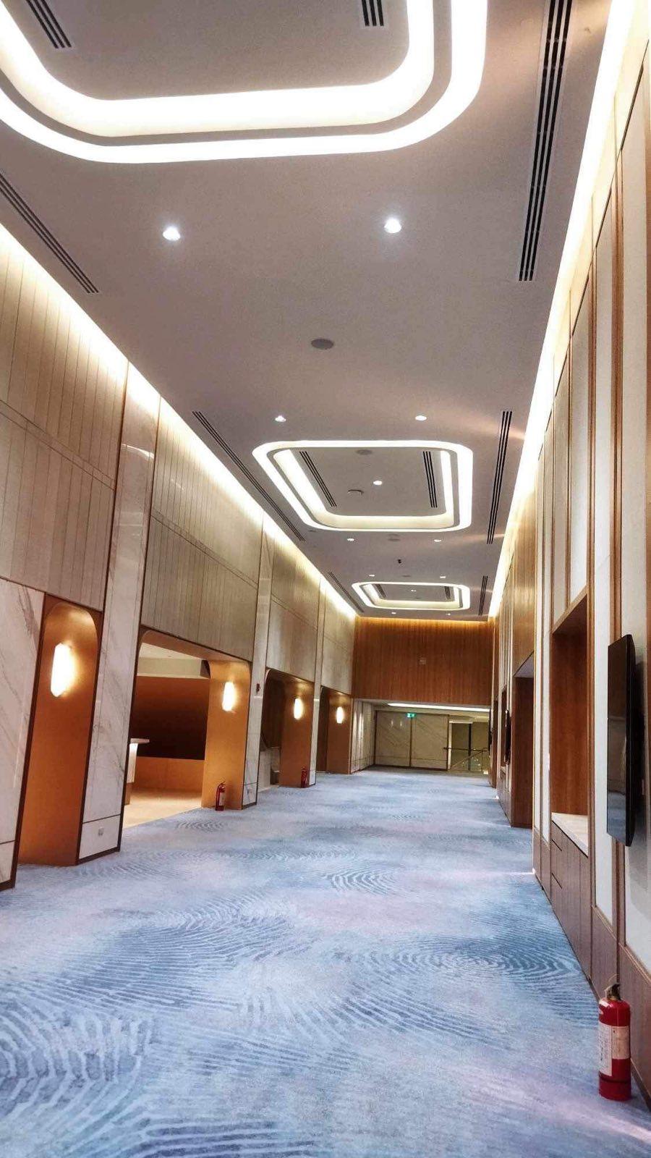
FIT OUT
Lanson Place at MOA installation of drywall and gypsum ceiling (from framing to final finish).

Slide 17
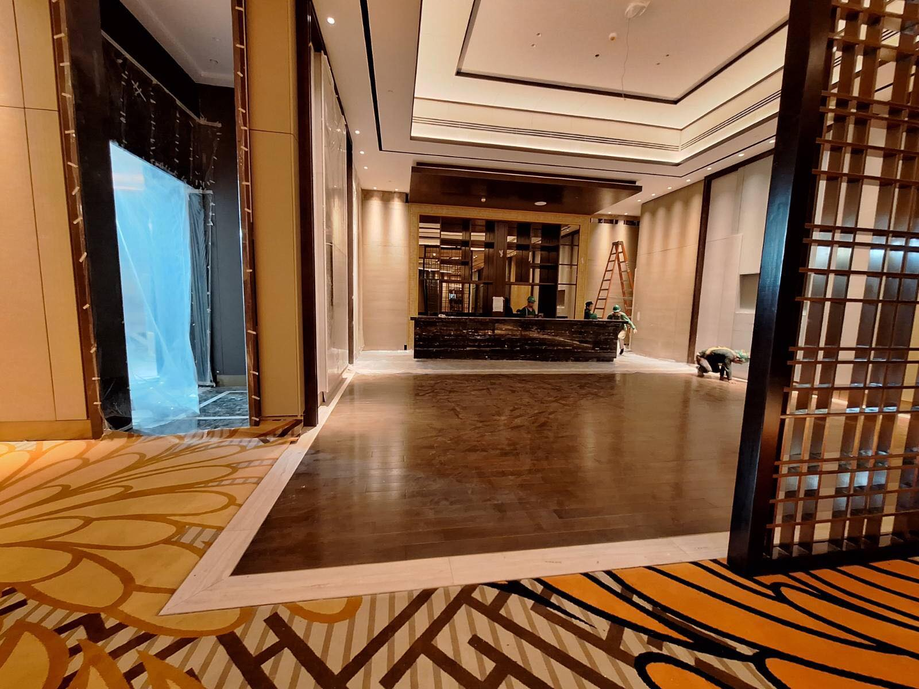
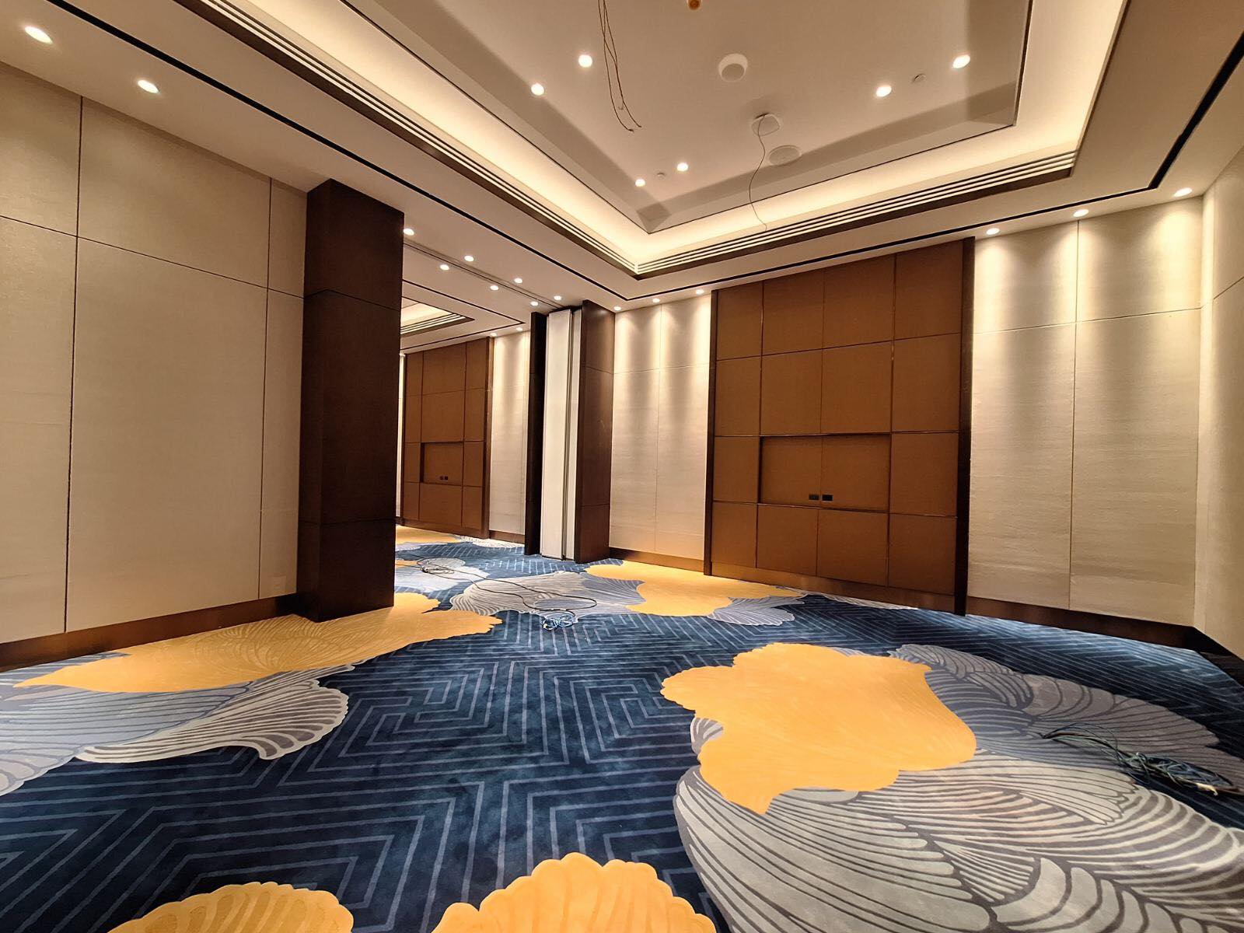
FIT OUT
Solaire North Hotel and Casino @ North Edsa QC installation of drywall and gypsum ceiling (from framing to final finish).

Slide 18
CONTACT INFORMATION

Slide 19
